Slide 1
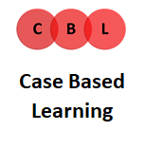
Year 3 Case-based Learning: Facilitator training 2023-24
Michael Trimble – Academic Lead for CBL Years 3 & 4
Michael McMahon – ADEPT Fellow 2022-23

Slide 2
Overview
Overview of Year 3
What is Case-based learning (CBL)?
Why use CBL?
Timeline
Roles
Case summaries
Materials
Sessions
Evaluation

Slide 3
Year 3 Overview
Longitudinal integrated clerkships
LIC 1: 4/9/23 – 15/12/23
LIC2: 29/1/24 – 27/5/24
Each has 7 weeks of medicine, 7 weeks of surgery
Range of learning opportunities
Notes:
In Y3, students enter Longitudinal Integrated Clerkships. This is where they become embedded in a base ward for a number of weeks and aim to become integrated within that healthcare team. There are two LICs, each lasting for 14 weeks and are separated by Christmas. Often there’s a split with 7 weeks medicine and 7 weeks surgery. There are a range of learning opportunities, offering a range of clinical experience.
We’re hoping that CBL will be a good way to help students apply what they’re learning on the wards.

Slide 4
What is CBL?
Holistic and integrated small group learning
Curriculum discovery
Integrating spiral themes
2021-22 pilot
2022-23 feedback
Notes:
CBL is an approach where students work through patient scenario in small groups, learning in a contextualised way, guiding curriculum discovery and integrating the spiral themes that are related to Outcomes for Graduates- these are the GCAT themes of “Global & Populational Health, Clinical Science & Practice, Achieving Good Medical Practice and Teamwork for Safe Care.
We carried out a pilot of cases in a previous academic year and have run it in 2022-23, to ensure it’s feasible and effective to deliver it within Longitudinal Integrated Clerkships. Feedback on how this has gone has fed into the design of CBL and how it will run for your students.

Slide 5
Why use CBL?
Student-centred, person-centred
Standardise experiences
Skills development
Integrated care
Clinical reasoning
Notes:
So why use case based learning? We really believe that CBL is an effective way to help students become the kind of doctors we want them to be. It’s student centred (in that it encourages students to take control of your learning in a self-directed way) and is also person-centred as it encourages them to view patients as a whole in a holistic way.
By using case based learning, CME are hoping to help standardise the student experience across the different trusts. As we’ve already alluded to, it’s an effective way for students to develop a range of skills such as communication, teamwork, problem solving and documentation.
CBL is also the way that we are hoping that students can develop clinical reasoning: how to think about things. We’re also hopeful that they’ll develop an understanding of what integrated care means. The cases have been developed by a wide range of healthcare teams, and we think the cases show a realistic journey of how a patient moves between different services.

Slide 6
CBL timeline
LIC1
LIC2
Sept – Oct
Case 2
Oct – Nov
Case 3
Feb – March
Case 4
April – May
Case 1
Notes:
So what’s our timeline for the year? You’ll have two cases within each LIC… <detail>
The cases are meant to last four weeks, but there’s a bit of variation here regarding progress test scheduling etc.

Slide 7
Case timeline
Week 1
Part 1 released on portal
Part 1 independent session 1
Week 2
Part 1 facilitated session 2
Week 3
Part 2 released on portal
Part 2 independent session 1
Week 4
Part 2 facilitated session 2
Notes:
Within those four weeks, this is what the case should look like.
Each case is split into two parts, and in week 1 the materials related to Part 1 will be released on the portal. Students should have a timetabled independent session, during which they should work through the materials. In the second week, they’ll have another session timetabled with you as a facilitator.
The same thing will happen for the next two weeks: the materials related to Part 2 will be released and the students have your independent session, with a facilitated session following the week after.
So generally, students will have four sessions, two without a facilitator and two with a facilitator. The exception to this is the first case, which I’ll talk about on the next slide.

Slide 8
Case 1 exception
Adjust to changes
All sessions have a facilitator
Only case with overview lecture
Notes:
So case 1 is an exception. Students will be familiar with CBL as they’ve had a lot of it in Years 1&2. But we expect them to have to make some adjustments to the new process in Year 3, and the greater expectations on them.
As a result, there’s some extra support set up for the delivery of Case 1: all sessions will have a facilitator alongside. That means rather than only being present for 2 out of the 4 sessions, you’ll be there for 4. This is just to help students as they grasp this new framework that we’ve provided, and help them see how they’re going to meet all the learning outcomes when they do this without a facilitator going forwards.
Case 1 will also be the only one with an overview lecture, to help them see how they can identify all the relevant learning outcomes in the cases going forward.

Slide 9
Student role
Group coordination
Independent sessions
Facilitated sessions
Framework
Teamwork and Professionalism
Notes:
So what is the role of the student? We’re asking the students to take more ownership during Y3 CBL, and work out how they’re going to work as a group.
In the independent sessions, they’re given the framework and materials and they’re asked to work through this themselves. They should allocate roles of a chair, deputy chair and scribe, and determine a session agenda to work out how they’re going to use their time wisely. This is something they should continue in the facilitated session.
Your role as a facilitator isn’t to teach them, but help guide them in the right direction. So they should really be taking ownership of the sessions.
A really important aspect of CBL is that of teamwork, and students are given some guidance & direction on how to work together effectively. Another important aspect is professionalism incl timekeeping, how they communicate with each other/themselves, and their general engagement & interaction with each other, with the materials, and with you as the facilitator.

Slide 10
Facilitator role
Facilitator training
Facilitator materials
Session delivery
Group allocation
Role during sessions
Notes:
What is your role?
We ask that you engage with this facilitator training. We ask that you familiarise yourself with the facilitator materials, which will be delivered by an email link to a platform called Causeway Learning. From here, you’ll be able to download all the relevant materials for your session.
We ask that you attend the timetabled facilitated sessions, with the group that you’re allocated to as co-ordinated by your trust.
Your role during the session can be a bit tricky to balance. We’re not asking you to teach them or deliver content, but rather to guide and direct students to how they can find information out.
During the sessions, the students will be discussing their learning, and we are asking facilitators to ask probing questions to explore the understanding within the group, and provide a small amount of feedback on whether what they’ve said is correct or not.
This is where the balance is: if students say something correct, we want you to encourage them to explore this further, but not monologue on the subject. If they say something incorrect, we want you to highlight this, ask if anyone else might know the answer here, and signpost them towards where they can learn more.
We’re suggesting the One Minute Preceptor Model for asking questions, and will explain more about this on a subsequent slide.

Slide 11
Guides and materials

Slide 12
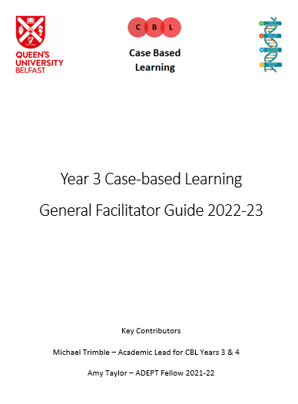
General guide
Overview
General learning outcomes
Framework
Roles
Sessions
Evaluation
Notes:
You have a general guide for the year, which provides some information on what you need to know to be a facilitator for the year.
There’s an overview of Y3 as well as an overview of CBL. There are some general learning outcomes for Y3 CBL, a detailed framework which Dr Trimble will go through now. It also outlines the roles of students and facilitator, shows how the sessions should run, and describes how we will evaluate CBL.

Slide 13
A structured approach to patient assessment and management
History
Examination and preliminary investigations
Differential diagnosis
Further investigations to confirm diagnosis
Management
GCAT themes
Notes:
History: In CBL, you will be presented with histories that have been taken by other members of staff. These purposefully have gaps to help you develop sills in critiquing and building on information from others.
Remember to maintain a structured approach to history taking and its critique. We have provided a framework below from your Clinical Skills sessions as a reminder.
Examination and ix: In CBL, students are encouraged to critique the examinations that have been recorded and identify other relevant examinations that the documented assessment might have neglected. Students are also provided with some basic investigations to assess and interpret.
In a system with finite resources and given the potential risks of every investigation, students should be able to explain the rationale behind each. These include:
Bedside investigations: What initial investigations are indicated and why? This may include urinalysis, ECG, ABG, etc.
Basic blood tests: What ‘routine’ bloods are necessary to check, and why are they relevant for diagnosis and/or management? These include clinical biochemistry and haematology tests.
Initial imaging: Consider the relevance in requesting initial imaging like chest x-ray or abdominal x-ray.
Ddx: In CBL, students are tasked with gathering information to develop a differential diagnosis. You are encouraged to apply a hypotheticodeductive process to understand and describe your clinical reasoning.
Sometimes use of a structure like the surgical sieve can support diagnostic approach. There are different mnemonics that can be used to help recall of such a framework for diagnostic thinking, such as: VITAMIN CDEF
Further ix to confirm dx:
In order to narrow down the differential diagnosis, and based on initial information that is gathered, further investigations will be requested. Students should consider:
Other laboratory tests: What other laboratory tests are relevant? These include microbiology, immunology, genetics, cellular pathology, histocompatibility and immunogenetics tests.
Imaging: Explain the best further imaging modalities recommended by guidelines, and their associated risks, taking into account individual patient factors.
Procedures: Depending on the presenting complaint, procedures may be indicated to obtain a specimen for analysis such as aspiration or biopsy. Other laboratory tests as above will be directly relevant to specimen analysis.
Specialist tests: Specific diagnostic tests may be indicated.
Screening: The working diagnosis may also indicate the need for relevant screening tests for associated problems.
Management: A biopsychosocial approach should be adopted to patient management as well as assessment.
Management should include:
Lifestyle and behavioural changes
Medication
Medical intervention
Surgical intervention
Psychological intervention
Social intervention
Spiritual and cultural support
Prevention strategies (primary and secondary)
Monitoring
Complications
Long-term follow-up
Integrated care
GCAT: Students are encouraged to work through the GCAT themes and identify relevant issues in the case related to global health, biomedical and behavioural sciences, professionalism (including ethics and law) and teamwork. These should be considered when writing learning outcomes. You should revise and apply the particular science relevant to the case.

Slide 14
Clinical reasoning
What is the problem?
What are the possible solutions?
What is the right solution for this patient?
Notes:
We’ve mentioned the importance of clinical reasoning a number of times already- this is an important part of medical practice and something we want to try and get you into the habit of doing. We want you to be thinking through cases, rather than just learning information about diseases & their treatments.
So every time a patient meets a doctor as a first presentation, there are 3 questions needing answered:
What is the problem?
What are the possible solutions?
What is the right solution for this patient?
So we need to define the problem, explore the solutions, and settle on the individual solution for the patient we’re dealing with. The first question is really about the diagnostic process. We’re using this framework here.

Slide 15
Clinical reasoning
Notes:
Students have been introduced to concepts underlying clinical decision making through lectures and tutorials. CBL in Year 3 provides the opportunity for students to apply these skills to clinical scenarios. Clinical reasoning is incorporated into case learning outcomes. Students should be encouraged to describe how their thinking has led to their conclusions.
Background
Solving clinical problems requires more than just knowledge of diseases and treatments. Clinicians need to be able to reason and evaluate and to do this we need to understand how we think, called metacognition, enabling us to have insight into problems and minimising error. The process can be broken down into a number of steps.
The hypothetico-deductive process
The hypotheticodeductive process consists of the following steps:
Data gathering
Information is gathered through history, examination, “routine bloods”, bedside investigations and imaging. A patient’s narrative should be actively questioned as it is interpreted, and sufficient information must be collected before conclusions are made. This forms the basis for hypothesis generation.
Hypothesis generation
There are several strategies to produce a list of differential diagnoses:
Pattern recognition: Patterns of symptoms and signs are identified, and more complex patterns can be recognised with practice. However, even experts must test their assumptions to prevent errors.
Rule out worst case scenarios: This supports risk management, but often leaves the diagnostic question unanswered.
Reasoning from first principles: This is applied when the pattern is unclear and further careful thought is required for underlying meanings to be identified.
The Casablanca strategy: This is the use of a standard battery of tests for a given symptom without any application of analysis, just like working on autopilot.
Hypothesis testing
Hypotheses must be examined and proved to be correct or incorrect by testing against knowledge and evaluating supporting data. A thoughtful and analytical approach is required.
There are two system approaches to judgement and choice. System 1 is fast, automatic, used frequently, and operates subconsciously. System 2 is slow, effortful, used infrequently, and requires conscious thought. When we are under pressure, we default to System 1 thinking, but a System 2 approach better serves clinical decision making. Bypassing this increases the risk of error. There are three basic types of error: skill based (slips and lapses), rule based, and knowledge based. Mistakes can also arise through a lack of understanding of the principles of logic.
Reflection
Finally, it should be it should be determined if conclusions are logical, coherent and sufficient for the patient presentation.
Summary
As we collect relevant information about a case, we also need to be aware of how we think and safeguard the process of how we make decisions that affect our patients. We can use cognitive forcing strategies, such as structured review of data and diagnostic checklists. We can also use resources to decrease dependence on memory. We can make ourselves accountable to the rest of the team for our thinking processes. Thinking “out loud” allows others to follow our train of thought - and permit challenge when our reasoning is flawed. It is important that we also develop skills in error recognition and recovery.

Slide 16
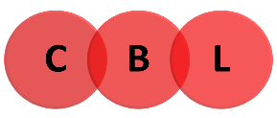
Framework
Science
Clinical
Clinical Science and Practice
Achieving Good Medical Practice
Teamwork for Safe Care
Global and Population Health
Psychological + Behavioural
Social
Read
Read the case materials, critique the assessment and interpret the investigations
Identify
Consider patient management and identify the issues raised in the case
Share
Share what you know about the issues
Assemble
Assemble the group’s overall knowledge and identify any gaps
Write
Study
Discuss
Write learning objectives
Study independently
Discuss independent learning
GCAT themes: Issues raised in the case

Slide 17
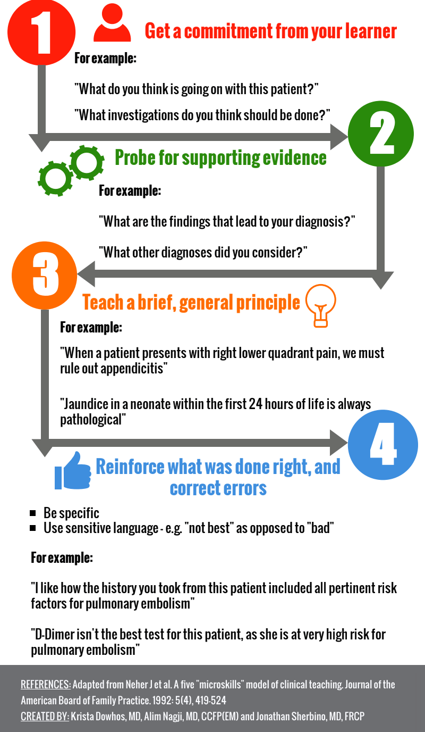
One Minute Preceptor Model
Learning outcomes discussed
Probing questions
Brief feedback
Integration of knowledge
Notes:
One of the ways we’re suggesting facilitators can enact this is a brief teaching tool called the One Minute Preceptor Model.
We’ve chosen this as it’s a useful way to encourage input from students while providing feedback on what they’ve researched.
The student chair should go through the case materials in the order they’re given, and students should mention their learning outcomes as they come up. If there are important omissions, feel free to prompt the group by asking some of the questions included in the case guides. Note that a number of topics may be selected from the learning outcomes which have been suggested. These are at the facilitator’s discretion. It’s important to note that we would not anticipate all learning outcomes being covered in every session.
As learning outcomes are discussed, you should ask probing questions to explore the students’ understanding, and as an opportunity to highlight or develop clinical reasoning.
To round out the L.O.s as they’re discussed, we would like facilitators to give some brief feedback on what has been discussed.
As we’ve already said, CBL is not about content delivery, but about integrating that knowledge. So we don’t want facilitators to turn this into a teaching session, but rather to highlight any correct/incorrect areas and signpost students to where they could find more information.

Slide 18
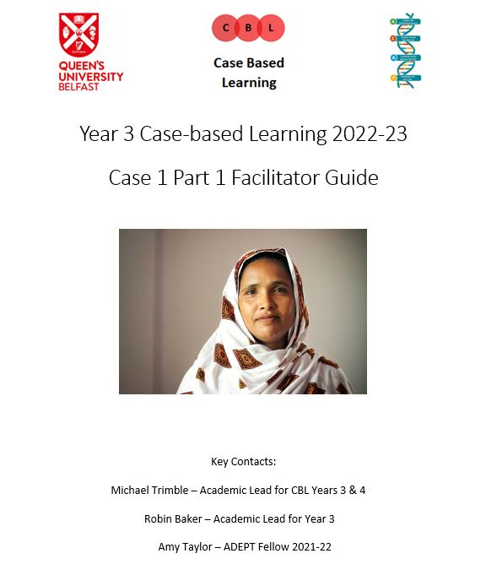
Case guide
Case summary
Learning outcomes
Resources
Key areas for discussion
Facilitator commentary
At a glance page
Notes:
So in addition to the information in your general guide, you’ll receive a guide for each part of each case.
Within, there’s a summary of what happens in the case; a list of learning outcomes (phrased as questions which you may want to ask the students if they aren’t covered); some resources to help direct student research; a short list of key areas for discussion; a facilitator commentary which is organised in a step-by-step process following the case narrative. This will include the points that should be highlighted from the case.
Lastly, for each case there is an “at a glance” page which is there to help you if you don’t he time to refamiliarize yourself with the case contents

Slide 19
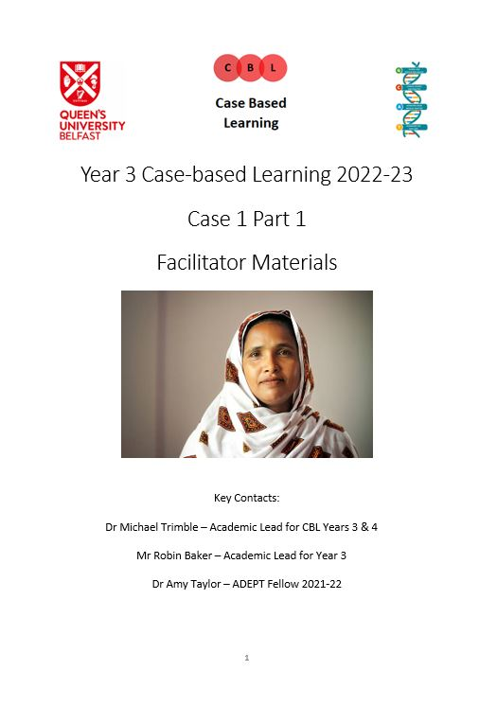
Case materials
Student materials
Additional materials for facilitated session
Medical documents
Investigations
Notes:
Also supporting each part of each case is a set of materials. Yours will differ slightly from the students, in that there will be some extra information for you to provide students later in the session. This is to help the patient’s story continue somewhat, and apply the knowledge that they might have gained between the independent and facilitated session. It’s also to help them see how real life happens, that things change, and think about what the outcomes might be.
Generally, these case materials include medical documents like patient notes, or investigations.

Slide 20
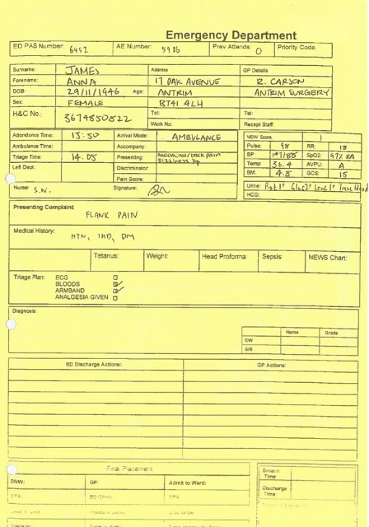
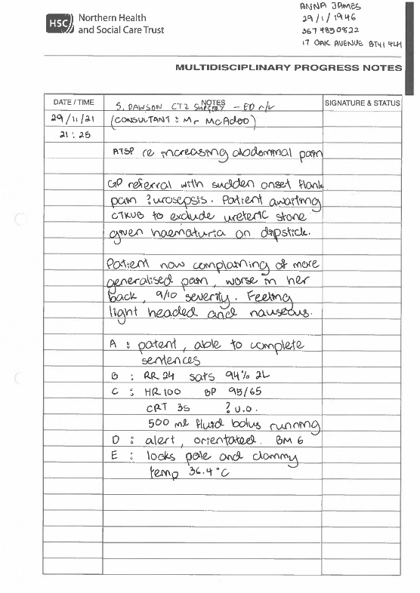
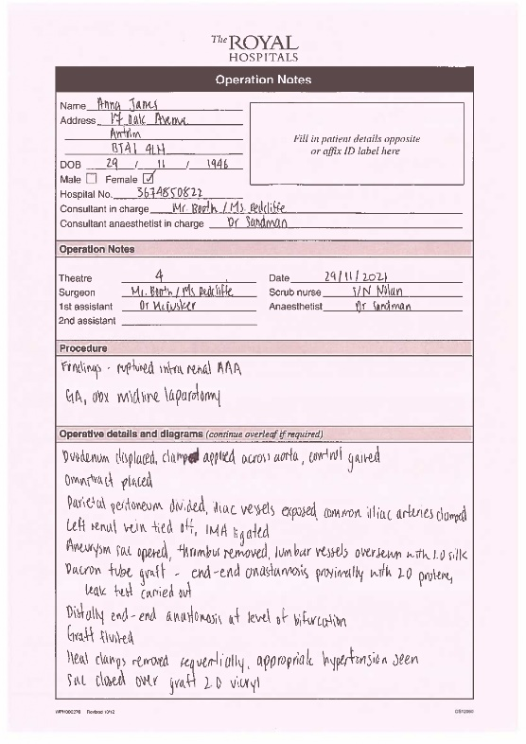
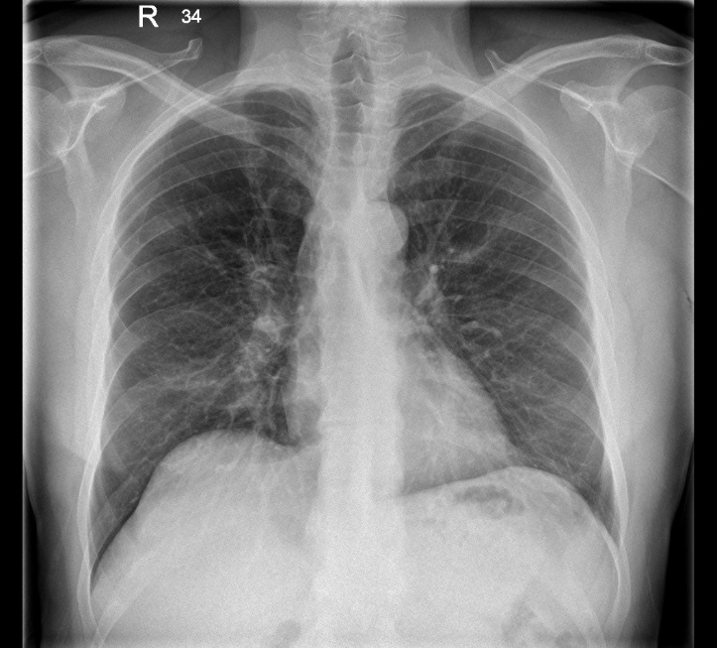
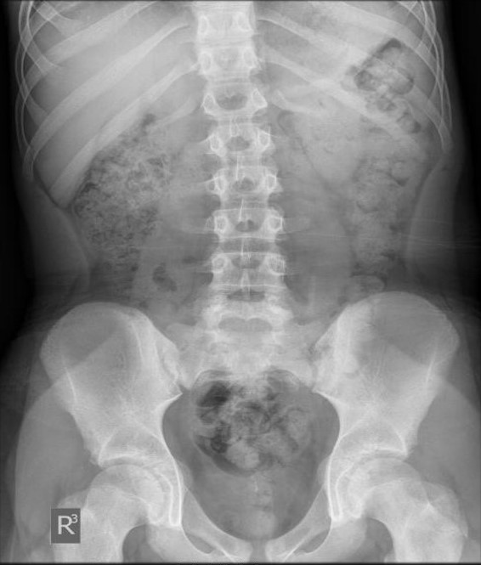
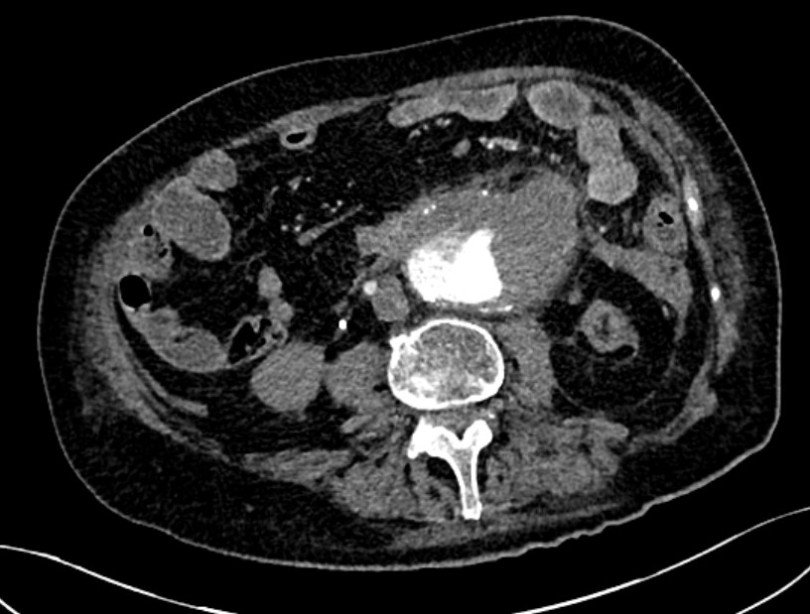
Number | 1 | Ref. Range (Units)
Collected | 29-Nov 2021 21:20
Signed | "
Source | BHSCT
Sample type Blood type Temperature FiO₂ | Blood Arterial 37.0°C 98%
pH pCO2 pO2 Na⁺ K⁺ Cl⁻ Ca²⁺ Glu Lac tHb Hct SO₂ BE cHCO₃ | 7.45 4.35 11.3 141 4.4 98 1.34 4.5 *3.7 *85 *0.29 94 0.6 23 | 7.350-7.450 4.30-6.40 (kPa) 11.00-14.40 (kPa) 133.0-146.0 (mmol/L) 3.50-4.50 (mmol/L) 95.0-108.0 (mmol/L) 1.150-1.350 (mmol/L) 4.0-7.7 (mmol/L) 1.0-1.4 (mmol/L) 115.0-180.0 (g/L) 0.370-0.540 (%) 94.0-98.0 (%) -2 - +3 (mmol/L) 22.0-29.0 (mmol/L)
Notes:
These are some examples of what the materials might look like. Thre are typed versions for accessibility in case there are difficulties reading the handwritten portions.

Slide 21
CBL sessions
Notes:
So now we’ll talk through what the sessions look like practically.

Slide 22
Independent sessions
1 hour
Group roles and agenda
Work through process
Suggested lesson plan
Notes:
As we’ve said, each part consists of an independent session and a facilitated session. In the independent session, the students should work through the materials by themselves for ~1h. They’ll decide and undertake the group roles of chair, deputy chair and scribe- these are to help them organise themselves and manage their time, as well as giving them opportunities to undertake leadership roles.
They should work through the framework that Dr Trimble has just explained, and

Slide 23
Independent session lesson plan | Duration
Introduction. Confirm group roles, agenda and ground rules. | 5 minutes
Summarise patient journey from previous parts (if relevant). | 5 minutes
Chair and Deputy Chair facilitate discussion on material. Work through tasks. | 20 minutes
Identify areas requiring research and agree group approach. | 20 minutes
Summarise main learning points and plan. | 10 minutes
Notes:
we’ve also given them a suggest lesson plan for them to use until they become familiar with the process themselves.

Slide 24
Facilitated sessions
1.5 hours
Group roles and agenda
Discuss learning
Additional materials presented
Notes:
Then there’s the facilitated session with you. It’s a bit longer at 1.5h, and again the roles of chair, deputy chair and scribe should be in place.
The session should include discussion of the learning. As we’ve mentioned, we don’t want this to be a presentation of serial PowerPoint slides, instead we want students to actually discuss what they’ve learned as a group. The chair should move through the case in the order of the case materials, and the learning outcomes discussed as they come up.
If there are any important omissions here, feel free to ask the questions in the case guide that we’ve provided you with.
After the narrative of the case is finished, you may reveal any additional materials that you have. This is just to get the students thinking, and apply anything they might have learned.

Slide 25
Facilitated session lesson plan | Duration
Introduction. Confirm group roles, agenda and ground rules. | 10 minutes
Summarise patient journey from previous parts and main learning points. | 5 minutes
Group discusses learning from independent session. | 30-40 minutes
Facilitator presents case development (if relevant). Chair and Deputy Chair facilitate discussion. | 20 minutes
Question time. Summarise main learning points. Revisit learning outcomes. | 10 minutes
Notes:
Again, here’s a suggested lesson plan for the facilitated session if that’s helpful.

Slide 26
General tips for small group sessions
Introductions and ice breakers
Ground rules
Use questions and summaries
Dealing with problems
Notes:
Some general tips for facilitating a small group. There’s some more information about this in your facilitated guide.
Generally it’s helpful to start with some general introductions and do consider an ice breaker.
In Years 1&2, students undertake group contracts to decide on how they’ll work together. It’s not something we’re asking for in Year 3 as we’re giving them more ownership of the process. But as a facilitator you may wish to highlight things like arriving on time or actively participating in discussion. It can be helpful to establish these at the start so if issues arise later on you can refer back to them.
We really want to encourage students how to find things out for themselves. So if students ask you a question there’s a balance to strike with encouraging students to think about how they can find out information. If they’re unsure, getting them to summarise what they’ve learned so far can b helpful for them to reset their thinking.
In terms of problems, sometimes these do arise. We’ve suggested some ways of managing those in the general guide. If you do have issues, do feel free to link in with the local undergraduate office to try and address these.

Slide 27
Evaluating progress and learning
Mandatory participation
MyProgress attendance
Formative assessment
Feedback surveys
Notes:
How will we evaluate CBL?
Attendance and participation is mandatory for students. You’ll be asked to help them log their attendance using MyProgress, a new app being introduced into QUB. This will involve you giving them your email address. You’ll get a verification email once they’ve done this, and you don’t need to do anything with that email unless it’s sent by a student who wasn’t actually there.
We’ve also told the students that the whole process of CBL is a type of formative assessment. We’re asking you as the facilitator to judge their engagement with the materials, with each other, and with you. If you have any concerns please address these with the students or local UG office.
Lastly, we’ll be coming in contact with you later in the year to get your thoughts on how it runs.

Slide 28
Case overviews

Slide 29
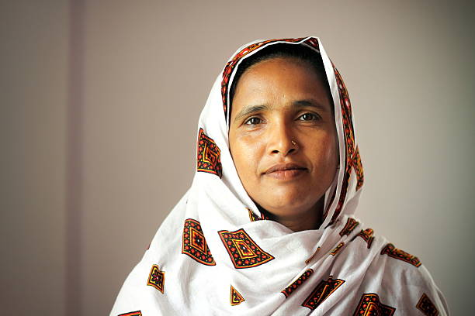
Case 1
Part 1: Altered bowel habit
Part 2: Peri-operative care and complications
Notes:
In case 1, the students meet a woman in her 60s called Farah Bibi. She presents with altered bowel habit & anaemia and part 2 deals with her diagnosis of colorectal cancer, peri-op care and complications of a PE.

Slide 30
Case 1
Part 1: Altered bowel habit
Part 2: Peri-operative care and complications
Interface of services
Cancer screening services
Clinical reasoning
Differential diagnosis
Problem lists
Evidence-based investigation and management
Multidisciplinary care for the patient with cancer
Risks of surgery and general anaesthesia
Consent for procedures
Pathology reports
Assessment of an acutely unwell patient
Prophylaxis and management of VTE
Escalation of care
Notes:
They key learning points are here.
She initially presents at a weekend to the emergency department, and we want students to consider the interface of services that are relevant there. She’d attended her GP with these symptoms who’s referred her as an outpatient but she’s worried over the weekend as her symptoms have worsened.
The GP has sent a QFIT test and is concerned her symptoms might be a presentation of cancer, so we’re asking students to consider cancer screening services.
As this is the first part of the first case, we’re really emphasising clinical reasoning, and we’re hoping that students can apply that. Included in that is developing a differential diagnosis and critiquing it, as well as developing their own problem list, before developing and critiquing investigation & management plans.
In part 2, she attends an OP surg appt and is diagnosed with colorectal cancer. She’s worked up for surgery, is admitted electively and undergoes a hemi-colectomy. Post-op she unfortunately has a PE.
So here we’re looking to explore the multi-disciplinary care a cancer patient has, the risks of surgery & GA and how this relates to the consent process.
They’re provided with a range of pathology reports which they should reflect on and the underlying science.
Assessing an acutely unwell patient becomes relevant as well as prophylaxis and management of VTE. Right at the end, we ask students to think about escalation of care as she deteriorates.

Slide 31
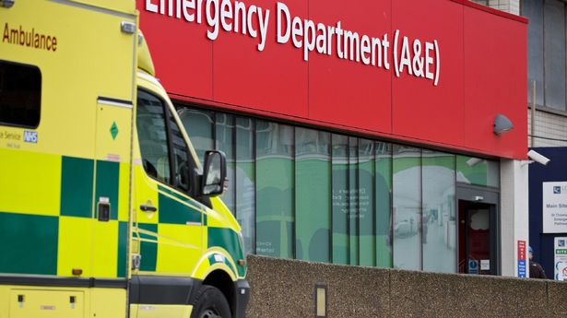
Case 2
Part 1: Emergency department attendance
Part 2: Discharge from Acute Medical Unit
Notes:
In case 2 our students encounter a student they’ve already met in CBL in years 1&2: James, who’s diagnosed with epilepsy.
In part 1 he takes an overdose of paracetamol and is brought in by ambulance. Part 2 follows his discharge from the acute medical unit after a short stay in ICU when he’s followed up by the community.

Slide 32
Case 2
Part 1: Emergency department admission
Part 2: Discharge from Acute Medical Unit
Pre-hospital care by NIAS
Assessment of an unconscious patient
Treatment of paracetamol and diazepam overdose
The role of higher levels of care
The impact on the partner and family, including child protection
Hyponatraemia
Depression and alcohol misuse
Suicide risk assessment
Discharge communication
Community follow-up
Notes:
So what are some of the main learning points we want to highlight here?
In part 1, we hope that students will consider the pre-hospital care provided by NIAS and how that process works.
They should consider how an unconscious pt is assessed and then we want students to note the importance of knowing how to treat a paracetamol overdose.
They should think about higher levels of care, what HDU/ICU mean and why that’s relevant for this patient, before thinking about this pt’s social background and the impact on the partner and family. Child protection will be relevant in this case.
In part 2, they’re discharged from ICU to AMU and eventually to the community.
He’s found to have a mild hyponatraemia and we’re keen that students look at how to assess and manage that.
He has a review by liaison psychiatry which introduces them to an assessment of depression and alcohol misuse and consideration of the management options and the importance of assessing suicide risk when someone presents with an intentional overdose.
We want students to then think about how his discharge is communicated. The discharge letter has some gaps, so we want students to figure out what they would tell the GP.

Slide 33
Case 3
Part 1: Back and flank pain
Part 2: Dyspnoea
Notes:
Case 3 will take place in LIC2, and again students have met this patient before in Years 1&2 CBL when he had an MI.
He’s come back with another vascular pathology, attending with back/flank pain to ED caused by a AAA. In part 2, he develops sudden SOB and unfortunately deteriorates further.

Slide 34
Case 3
Part 1: Back and flank pain
Part 2: Dyspnoea
Emergency transfer in the community
Differential diagnosis of flank pain
Social determinants of health
Professionalism – duty of candour
Opportunities for health promotion and intervention
Cardiac anatomy and physiology
Complications post-MI
AKI and hyperkalaemia management
Levels of care
Ceilings of care discussions and decisions
Professional responsibilities relating to end of life care
Notes:
His journey in case3 is another very difficult one.
In part 1 he phones his GP who is concerned about his sudden onset pain and sends him straight to ED. We want students to think about the importance of emergency transfer in the community through that story.
He presents with back/flank pain, and students should consider these differentials as well as why he presents in the way he does. He doesn’t tend to interact much with healthcare and what does that mean for his presentation. Based on this, students should think about the opportunities for health promotion and intervention.
Duty of candour is relevant here, as he’s initially incorrectly diagnosed with renal colic instead of an aortic aneurysm. We want students to think about how that conversation would be, in acknowledging the error made.
In part 2, after his emergency vascular surgery he’s had another post-op MI and is less well, he hasn’t got out of bed.
Students are encouraged to think about what complications can happen post-MI such as NSVT, and cardiac anatomy/physiology is relevant here.
Then he becomes very unwell, developing cardiogenic shock, renal failure, pulmonary oedema and hyperkalaemia. We want students to think about managing some of these but really to consider levels of care.
It’s different from case 1 as this patient is not fit. At the end of the case, students are encouraged to consider those challenging discussions & decisions, how they’re made and how we professionally approach them and those around end of life care.

Slide 35
Case 4
Part 1: Multimorbidity
Part 2: Falls assessment
Notes:
Case 4 is largely set in the community, picking up another patient who the students will have met in Years 1&2 CBL when he had a hip and knee replacement.
He comes to his GP with lots of issues making him generally and non-specifically unwell, and the GP works him up for a range of multi-morbidities and falls.
He’s sent to a falls assessment clinic and has an extensive review by the MDT in part 2.

Slide 36
Case 4
Part 1: Multimorbidity
Part 2: Falls assessment
Community acquired pneumonia
Community triage
Chronic disease management
Multimorbidity
The patient journey
Falls assessment and management
Sarcopenia and frailty
Polypharmacy
Monitoring and follow-up
Notes:
They key points for discussion are shown here.
In part 1, CAP is relevant as they’ve had a recent discharge from hospital treated for this. Community triage is relevant as he phones the GP.
Then there’s a range of chronic diseases that the GP goes about managing, calling the impact of multimorbidity into question. And we’re thinking about the impact on the patient, on their family, and on services.
Again, the students will think about the patient journey with all these things going on.
In part 2 he attends the falls clinic and undergoes a detailed MDT assessment.
Issues include sarcopenia, frailty and polypharmacy. Students are encouraged to think about how this man will be monitored and followed up going forward.

Slide 37
Key points
Skills development
Framework and process
Teamwork and professionalism
Clinical reasoning
Integrated care
Feedback
Notes:
So to just to bring back our key points for CBL in Year 3, the focus is on skills development. We want them to bcome familiar with this process, writetheir own learning outcoms and take a self directed approach to their learning.
Teamwork and professionalism are key aspects, as well as clinical reasoning and appreciation of how care is integrated.
We’re really interested in how it goes and will be really grateful for your feedback if you will provide it.

Slide 38
Acknowledgements
Amy Taylor ADEPT Fellow 2021-22
Philip Toner Academic Lead for Year 3
Robin Baker Deputy Academic Lead for Year 3
Andrew Spence Academic Clinical Lecturer
Jenny Johnston Academic Lead for Year 3 GP
Paul Hamilton Academic Lead for CBL Years 1 & 2
Charles Mullan Honorary Lecturer, Radiology
GCAT Theme Leads
Sophie Davidson General Surgery ST5
Mark McKane Cardiology ST4
Peter McMurray General Adult Psychiatry ST6
James Irvine Geriatric Medicine ST4
Notes:
There are a great many people from a range of specialities/fields/interests who’ve developed these cases and we just want to acknowledge them and say thank you.

Slide 39
Thank you
What are your questions?
Contact: m.trimble@qub.ac.uk
Notes:
Lastly, a big thank you to you! We hope it’s a really good opportunity to help students develop these skills and are really grateful for your help with this.

